Slide 1
Seguridad_CDMX
Varenka Rico Jaime
Hugo Bárcenas López
Benjamín Tello Bravo
José Luis Mendoza Luna

Slide 2
Claudia, maybe we could help.
Define the core message or hypothesis of your project.
Ho: The demographic factors of an alcaldia does not influence in the amount of felony's committed in that alcaldia.
Ha: The demographic factors of an alcaldia influence in the amount of felony's committed in that alcaldia.

Slide 3
Claudia, maybe we could help.

Slide 4
Questions & Data
We found our resource data trough the open data of the government of the city of Mexico. Specifically :
Carpetas de investigación PGJ de la Ciudad de México
Alcaldías
Presupuesto de egresos de la Ciudad
And INEGI / CONEVAL :
Population variables from “Censo poblacional 2010”.:
Total population
Average schooling
Economically active population
Unoccupied population
Population without religion as a fun fact
Variables related with poverty from: “Estudio de medición de la pobreza 2015”.
Extreme poverty
Moderate poverty
Vulnerable population by income
Population with income below the welfare line

Slide 5
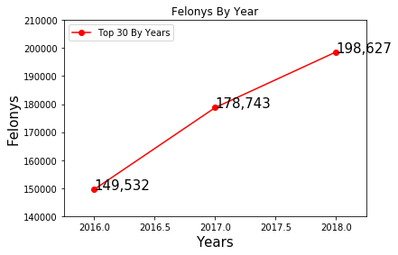
Questions & Data
Is the amount of felonies committed in CDMX increasing?

Slide 6
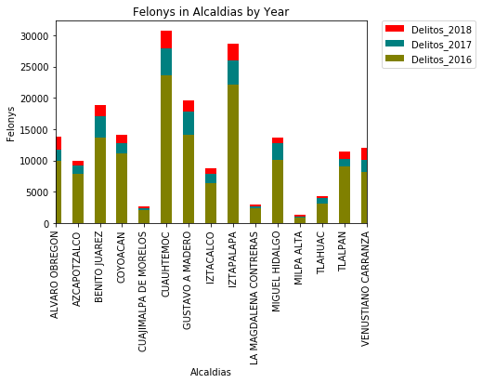
Questions & Data
In which alcaldia are occurring the most felonies?
Does the amount of population in each alcaldia determine the amount of felonies occurring?

Slide 7
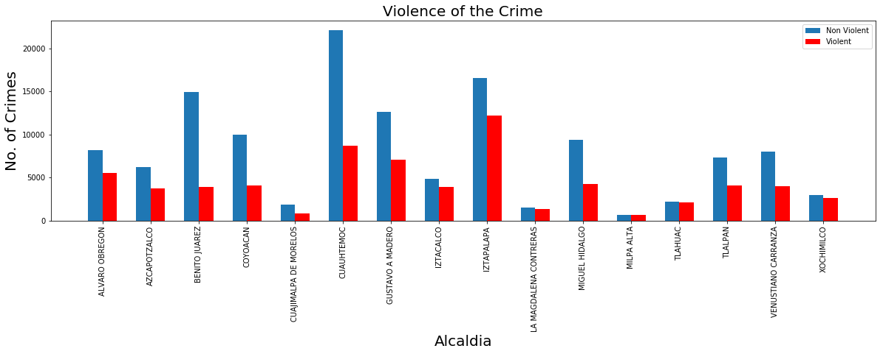
Questions & Data

Slide 8
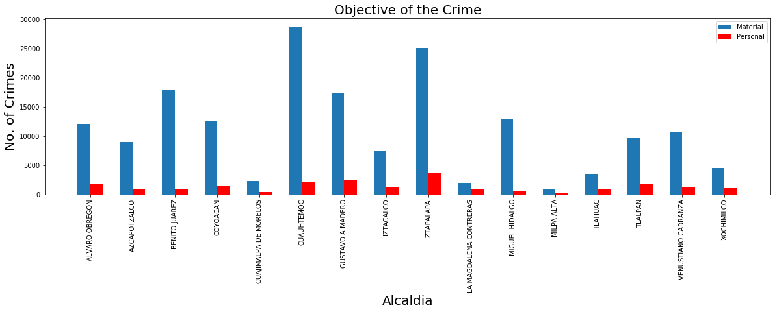
Questions & Data

Slide 9
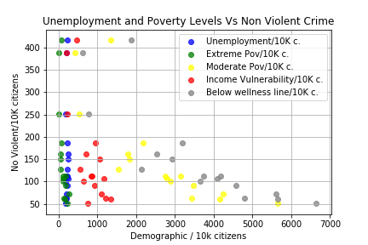
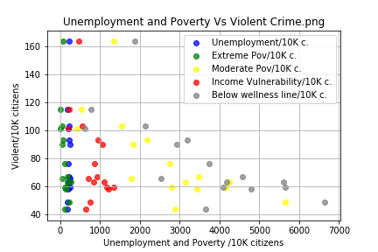
Data Analysis

Slide 10
Questions & Data

Slide 11
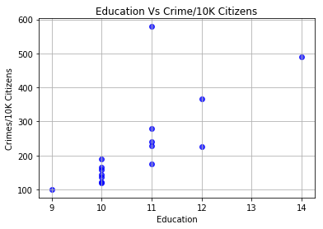
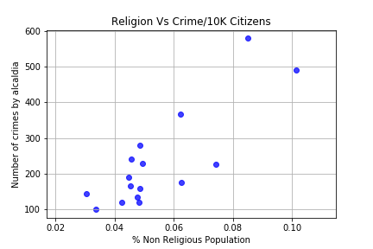
Questions & Data

Slide 12
Data Cleanup & Exploration
INEGI and CONEVAL databases (Jupyter notebook sociodemo).
Presupuesto de egresos de la Ciudad.
Carpetas de investigación PGJ de la Ciudad de México.

Slide 13
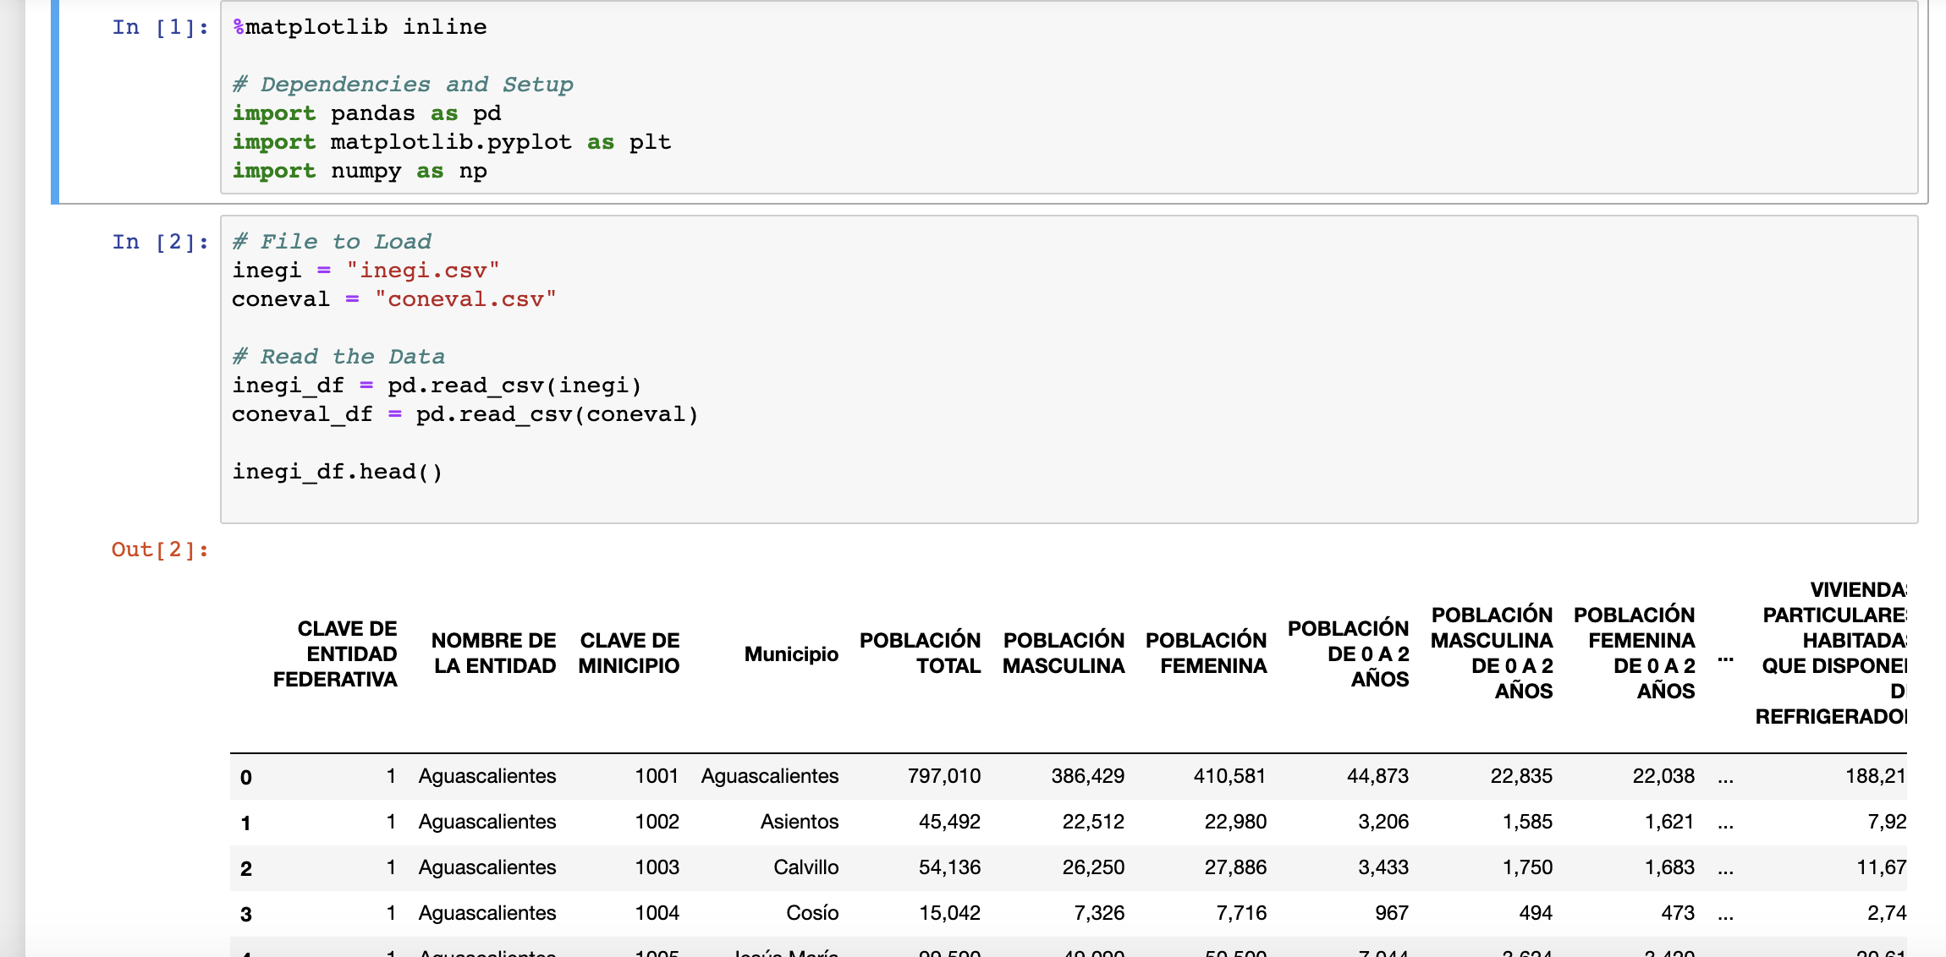
Data Cleanup & Exploration

Slide 14
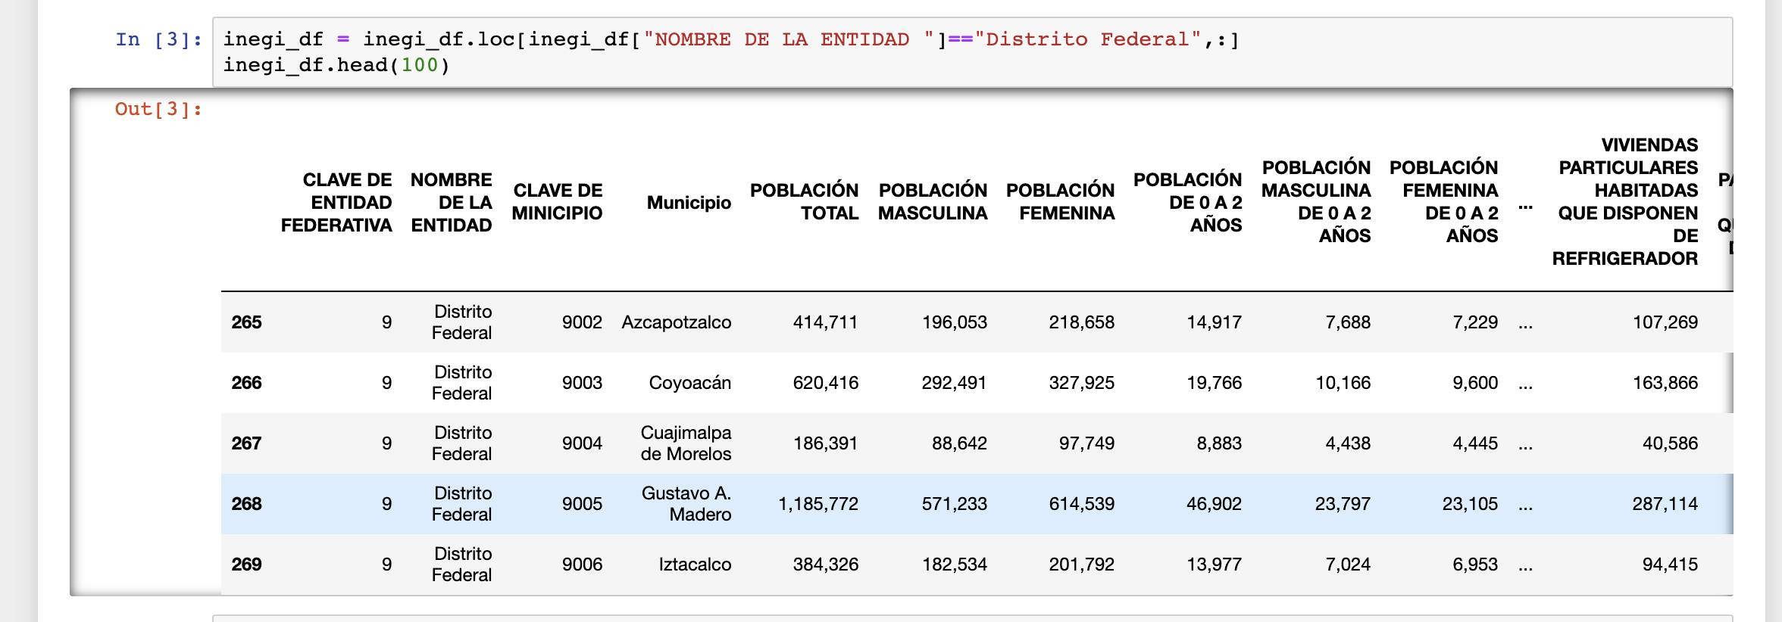
Data Cleanup & Exploration

Slide 15
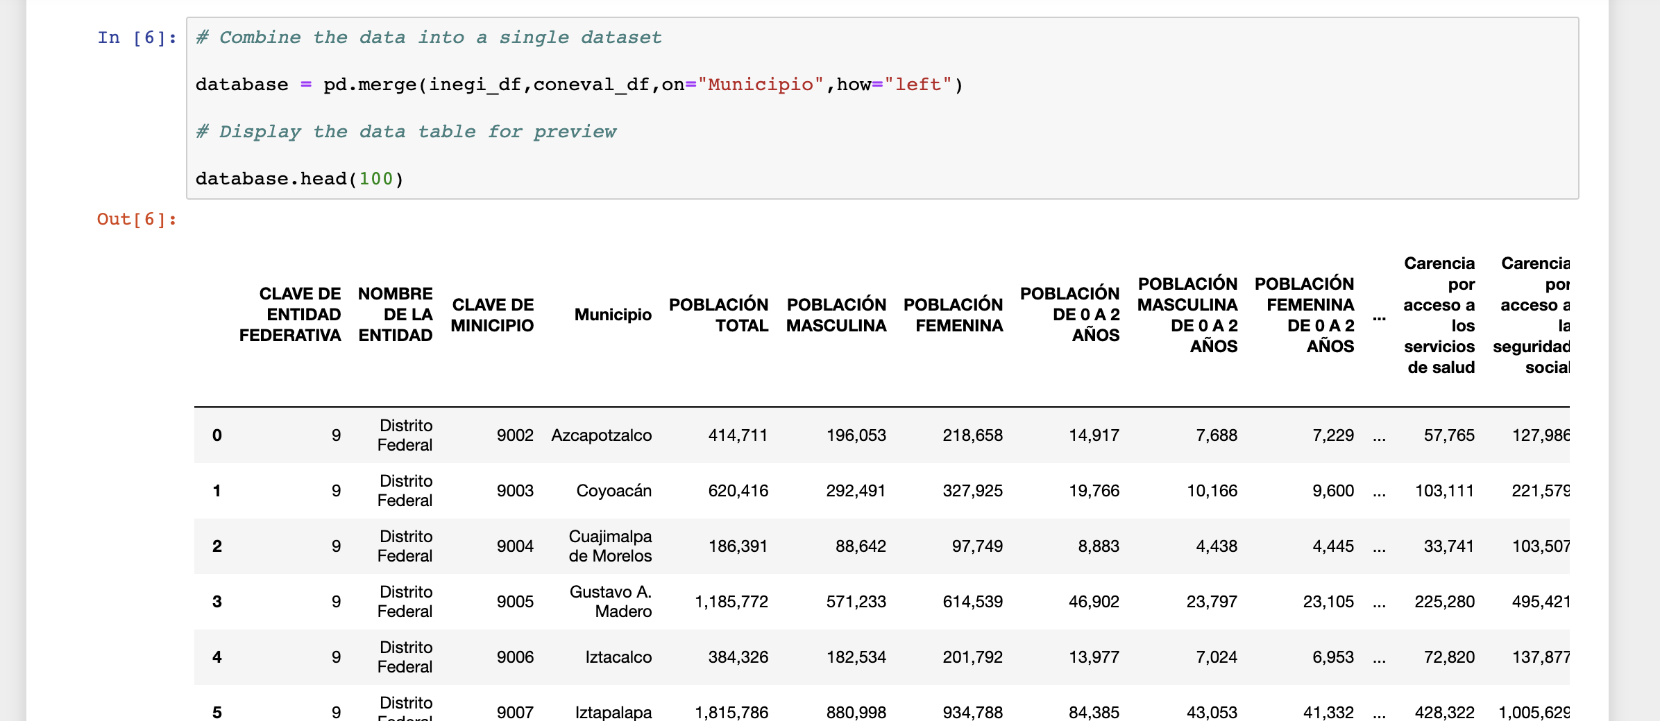
Data Cleanup & Exploration

Slide 16
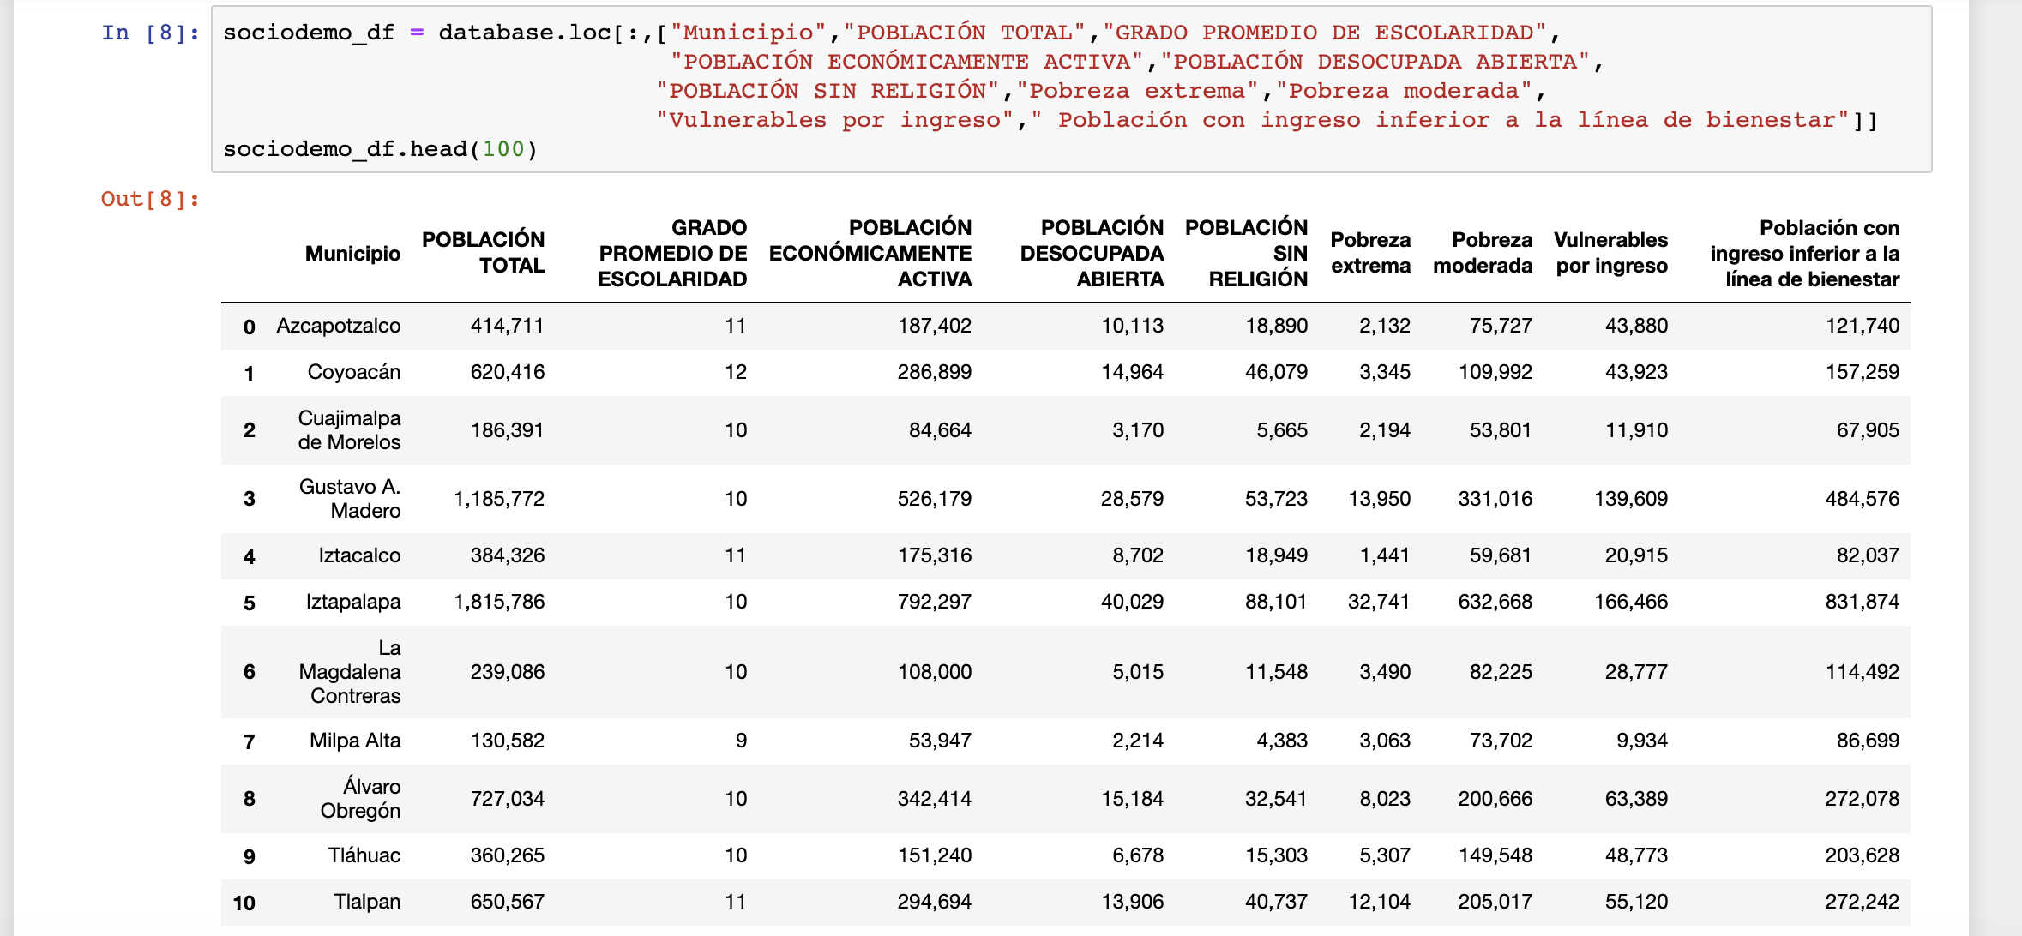
Data Cleanup & Exploration

Slide 17
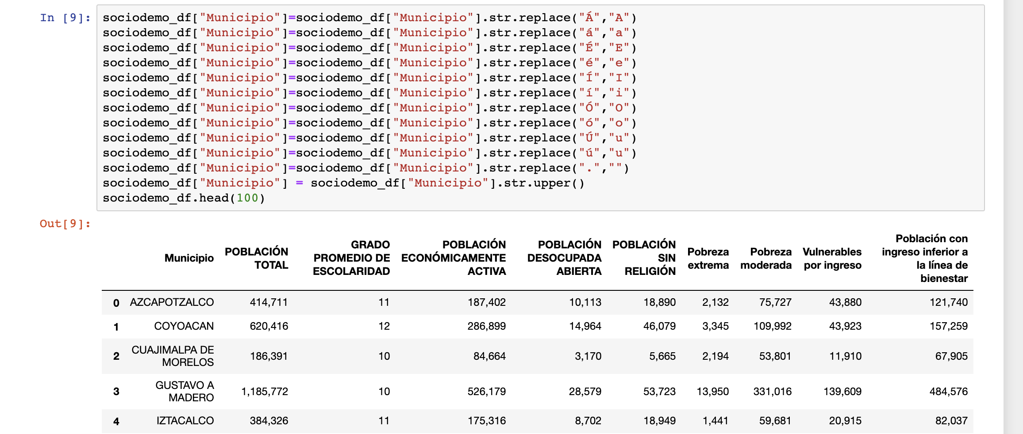
Data Cleanup & Exploration

Slide 18
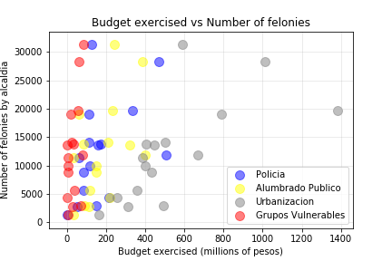
How the spending in different items is associated with the number of crimes committed in each alcaldía?

Slide 19
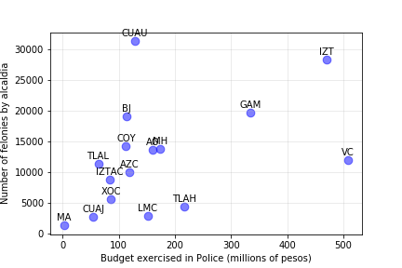
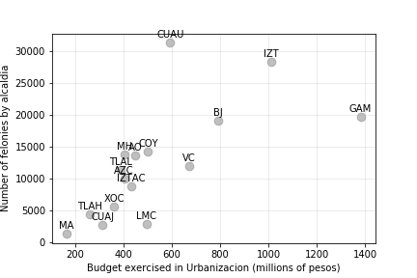
The relation between spending and felonies

Slide 20
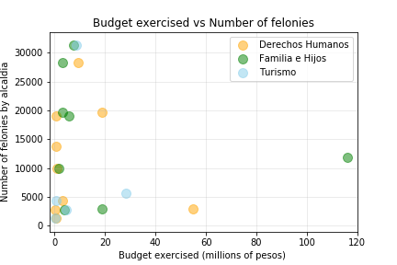
The relation between spending and felonies

Slide 21
RegresSion analysis
We estimate the following linear regresion model:
delitos= a +b*spending_in_police + e
And test for the significance of coefficient b. That is:
H0: b = 0
HA: b != 0

Slide 22
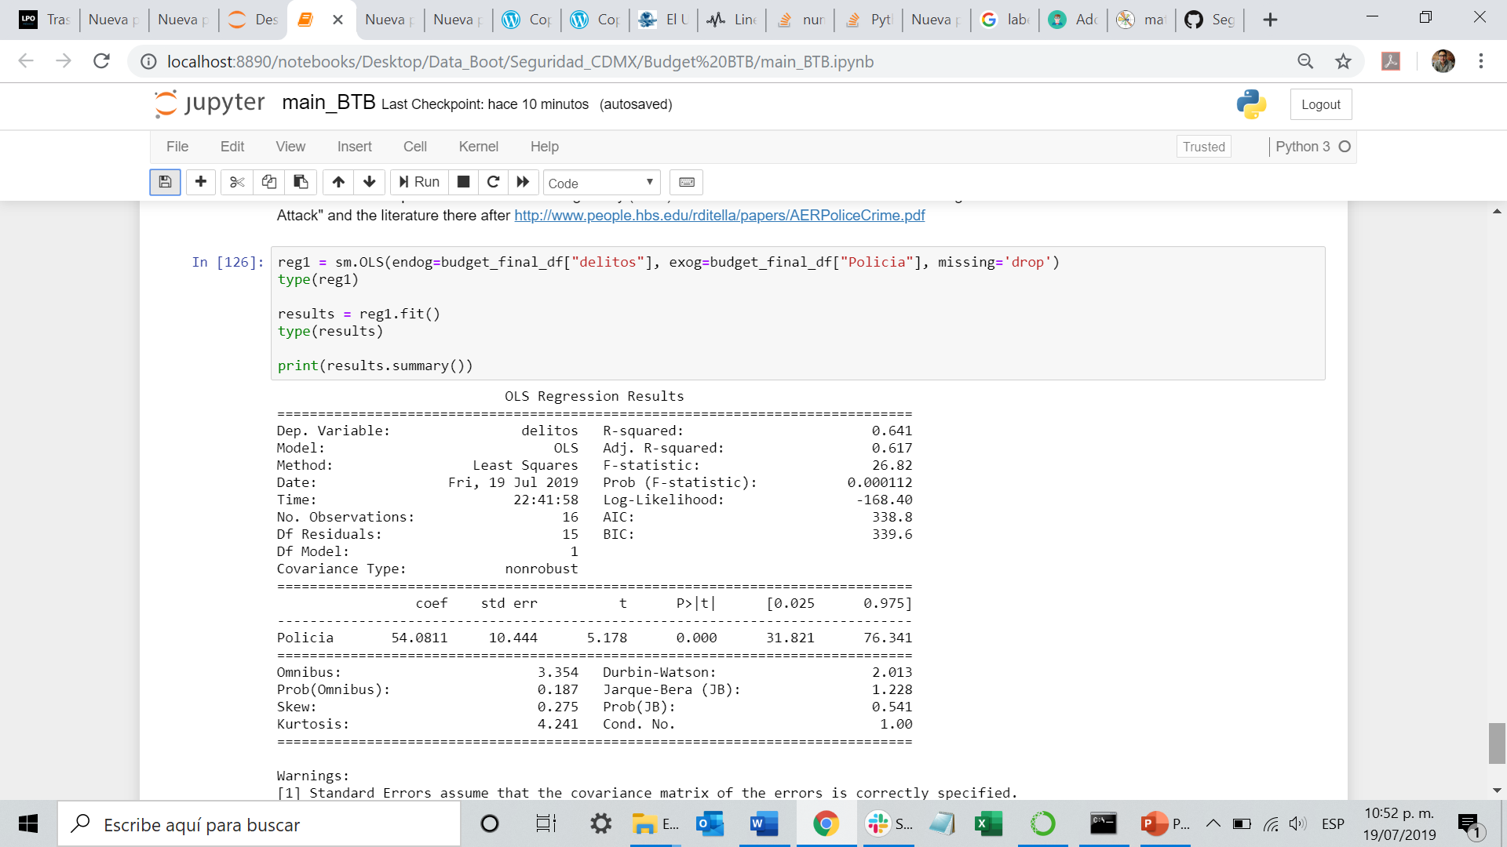
RegresSion análisis (Results)
Results show a positive association (obviously not causation) between spending in police by alcaldia and crime. Estimated coefficient b is positive and statistically significant. Moreover, R squared is high. These results are consistent with the literature on crime that suggests that resources for crime prevention and crime combat are directed to hotspots.
For more on this topic see Di Tella and Schargrodsky (2004) "Do Police Reduce Crime? Estimates Using the Allocation of Police Forces After a Terrorist Attack" and the literature there after http://www.people.hbs.edu/rditella/papers/AERPoliceCrime.pdf

Slide 23
Post Mortem
Discuss any difficulties that arose, and how you dealt with them
Discuss any additional questions that came up, but which you didn't have time to answer: What would you research next, if you had two more weeks?

Slide 24
Questions
Open-floor Q&A with the audience

